Slide 1
University Catalogue Explorer
By: Stephen Heeps
Jeff Paige
Justin Smith

Slide 2
What is the UCE?
University Catalogue Explorer
Explore your university's course offerings.
Find what other students thought of the courses.
Easily accessible professor evaluations.
Integrated schedule construction tools.
Notes:
Justin

Slide 3
Why?
Make both students and academic advisor’s lives easier.
Reduce schedule creation confusion and time investment.
Allow students to openly discuss their experiences.
Provide centralized tool for many different utilities.
Plan multiple semesters in advance.
Notes:
Justin

Slide 4
How will it be made?
Hyper Text Markup Language
Cascading Style Sheets
JavaScript
PHP: Hypertext Preprocessor
Structured Query Language
My(Structured Query Language)
Visual Studio 2013
Notes:
Jeff

Slide 5
How does it work?
Search function to search for classes/universities
Universities can upload catalogues into database
Students can access catalogue of majors/minors/concentrations/etc.
Outline of classes to take per semester
Notes:
Stephen

Slide 6
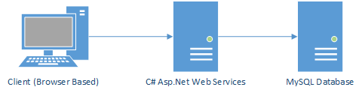
How does it work pt.2
Utilization of 3-Tier Architecture
Notes:
Stephen

Slide 7
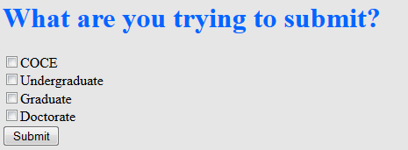
How does it work pt.3
Notes:
Stephen

Slide 8
How does it work pt.4
C# WCF Web Services
Simple Object Access Protocol
Framework for data transfer
Acts as an intermediary between the client browser and the database
Notes:
Jeff

Slide 9
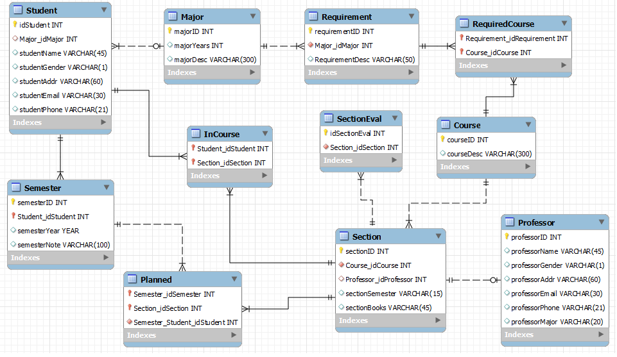
How does it work pt.5
Notes:
Justin

Slide 10
How does it work pt. 6
Concerns for security
Things to consider:
Secure Session Tracking
Encryption for login procedures
Encrypting/Salting/Hashing Stored Passwords
Sanitizing inputs for database
Notes:
Jeff

Slide 11
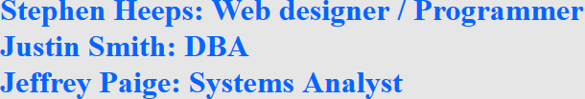

Q&A?

